Slide 1

M21DE0303 - Minor Project Master of Computer Applications - MCA III Semester – 2024
School of Computer Science and Applications

Slide 2
A Machine Learning Approach to Predict Insomnia
Presented by : A.Ayyappa Swami(R22DE004)
G.Vamsi Krishna(R22DE043)
Under the Guidance of: Dr.Ambili PS
(Associate Professor)

Slide 3
Outline
Abstract
Introduction
I. Problem Statement
II. Motivation
System Specification
Dataset and Description
Data Preparation
Model Planning
Model Building
Results
Conclusion and Future Enhancements
References

Slide 4
1. ABSTRACT
The world is changed extremely over the last decade by the power of technology. Consequently, human lives are undergoing multiple changes that have both positive and negative effects on human health. A lot of virtual involvements, lack of physical activity and extreme use of radio-wave devices are leading people into various health-related issues and Insomnia is one of them. The disorder is also known as sleeplessness. This can occur independently or can occur as a result of another problem. This may turn into permanent disease and chronic(long-time) insomnia can seriously damage a human brain. However, the presence of insomnia can be detected by different medical tests according to various internal factors of sleep. But this kind of approach is not only expensive but also time-consuming. Expensive tests and equipment are also not available in many developing countries. To bridge this gap we have decided to build an intelligent model based on a machine learning approach that is able to predict chronic insomnia. For acquiring best results 5 different machine learning classifiers were used.

Slide 5
2. Introduction
A project dedicated to helping people achieve better sleep by predicting and understanding insomnia. Insomnia, a common sleep disorder, can affect our daily lives and well-being. This project combines the power of machine learning with diverse data sources, like surveys, wearable devices, and health records, to create a smart model that predicts the severity of insomnia.
2.1 Problem Statement
Insomnia is a prevalent sleep disorder that significantly impacts the well-being and daily functioning of individuals. Predicting and identifying the risk of insomnia early on can aid in proactive intervention and personalized care. This project aims to develop a machine learning model for predicting insomnia based on various features related to sleep patterns, behavior, and other relevant factors
2.2 Motivation
Insomnia, characterized by difficulty falling asleep, staying asleep, or experiencing non-restorative sleep, is a widespread and often underestimated health concern. The motivation for developing a machine learning model to predict insomnia stems from the profound impact that sleep disorders can have on an individual's physical and mental well-being.
5

Slide 6
3. System SPECIFICATIONS
Hardware Requirements:
❖ A multi-core processor (quad-core or higher) to expedite model training and data processing.
❖ Sufficient RAM (at least 8GB, preferably 16GB or more) to handle large datasets and complex machine learning models efficiently.
2. Storage:
❖ Adequate storage space for storing datasets, model files, and other project-related files.
3. Software Requirements:
Computational Power:
❖ Google colab
❖ Python
❖ Libraries: Pandas, NumPy, Scikit learn, Matplotlib.
6

Slide 7
4. DATA SET AND DESCRIPTION
The datasets used in this work was obtained from Kaggle. the dataset contains 374 rows and 13 columns. This means there are 374 samples or instances in the dataset, with each sample having 13 attributes or features associated with it.
The dataset appears to be structured as a tabular dataset, possibly stored in a CSV (Comma Separated Values) file or a similar format.
Each row represents information about a single individual, and each column represents a specific attribute or feature of that individual.
Person ID: This is likely a unique identifier for each individual in the dataset.
Gender: Categorical variable representing the individual's gender (e.g., male, female, non-binary).
Age: Numerical variable indicating the individual's age.
Sleep Duration: Numerical variable representing the average or habitual sleep duration of the individual (e.g., hours per night).
Quality of Sleep: Categorical variable representing the perceived quality of sleep (e.g., good, poor, average).
Physical Activity Level: Categorical variable representing the individual's physical activity level (e.g., sedentary, moderately active, very active).
7

Slide 8
Stress Level: Categorical variable representing the individual's perceived stress level (e.g., low, moderate, high).
BMI Category: Categorical variable representing the individual's Body Mass Index (BMI) category (e.g., underweight, normal weight, overweight, obese).
Blood Pressure: Numerical variable representing the individual's average blood pressure readings.
Heart Rate: Numerical variable representing the individual's average heart rate.
Daily Steps: Numerical variable representing the average number of steps taken by the individual each day.
Sleep Disorder: Categorical variable indicating whether the individual has been diagnosed with a sleep disorder (e.g., yes, no).
This dataset offers valuable insights into the relationship between various factors and sleep disorders. By analyzing the data, researchers could potentially identify risk factors for sleep disorders, develop predictive models, or evaluate the effectiveness of interventions aimed at improving sleep quality
8

Slide 9
5. DATA PREPARATION
Identify and Handle Missing Values:
Check for missing values in each column and decide on an appropriate strategy to handle them (e.g., imputation, removal).
Data Type Conversion:
Ensure that each column has the correct data type. For example, 'Age' should be numeric, 'Gender' could be categorical, and 'Occupation' might be categorical as well.
Normalize/Scale Data:
If necessary, normalize or scale numerical features to ensure they are on a similar scale. This is especially important for machine learning algorithms that are sensitive to feature scaling.
Encode Categorical Variables:
Convert categorical variables like 'Gender', 'Occupation', 'BMI Category', and 'Sleep Disorder' into numerical representations using techniques like one-hot encoding or label encoding.

Slide 10
Remove Outliers:
Identify and remove any outliers in the data that may skew the analysis or model training. This could be done using statistical methods or domain knowledge.
Feature Selection:
If the dataset contains a large number of features, consider performing feature selection techniques to reduce dimensionality and focus on the most relevant features.
Split Data into Training and Testing Sets:
Split the data into training and testing sets to evaluate the performance of the model.
Balance the Dataset (if necessary):
If the dataset is imbalanced (e.g., significantly more samples of one class than another), consider techniques such as oversampling, undersampling, or synthetic data generation to balance it.
Review and Iterate:
Review the prepared data and iterate on the steps as necessary based on insights gained during analysis or modeling.
These are just some general steps, and the specific approach may vary depending on the characteristics of your dataset and the goals of your analysis or modeling task.

Slide 11
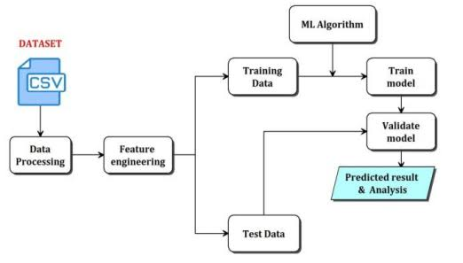
6. Model planning

Slide 12
Decision Tree:
• Working Process:
1. Decision Tree recursively splits the feature space into partitions based on feature values.
2. At each node, the algorithm selects the feature that best separates the data according to a chosen criterion (e.g., Gini impurity, entropy).
3. The splitting process continues until a stopping criterion is met, such as reaching a maximum tree depth, minimum number of samples in a leaf node, or purity threshold.
4. During prediction, new data samples are traversed down the tree based on feature values until a leaf node is reached, and the majority class in that node is assigned as the prediction.
Naïve Bayes:
• Working Process:
1. Naïve Bayes calculates the conditional probability of each class given the input features using Bayes' theorem: 𝑃(𝑦∣𝑋)=𝑃(𝑋∣𝑦)×𝑃(𝑦)𝑃(𝑋)P(y∣X)=P(X)P(X∣y)×P(y).
2. It assumes that the features are conditionally independent given the class, simplifying the computation to 𝑃(𝑋∣𝑦)=𝑃(𝑥1∣𝑦)×𝑃(𝑥2∣𝑦)×...×𝑃(𝑥𝑛∣𝑦)P(X∣y)=P(x1∣y)×P(x2∣y)×...×P(xn∣y).

Slide 13
3. During prediction, it selects the class with the highest posterior probability as the predicted class.
Linear Regression:
• Working Process:
1. Linear Regression models the relationship between the dependent variable 𝑦 one or more independent variables 𝑥1,𝑥2,...,𝑥𝑛x1,x2,...,xnusing a linear equation: 𝑦=𝛽0+𝛽1𝑥1+𝛽2𝑥2+...+𝛽𝑛𝑥𝑛+𝜖y=β0+β1x1+β2x2+...+βnxn+ϵ.
2. The coefficients 𝛽0,𝛽1,...,𝛽𝑛β0,β1,...,βnare estimated using techniques like ordinary least squares (OLS) or gradient descent to minimize the residual sum of squares.
3. During prediction, the model computes the predicted values of 𝑦ybased on the
learned coefficients and input features.
Support Vector Machine (SVM):
1. SVM finds the optimal hyperplane that best separates the classes in the feature space by maximizing the margin between the classes.
2. It maps the input data into a higher-dimensional feature space using a kernel function to make non-linear separation possible.

Slide 14
3. The optimal hyperplane is selected to maximize the margin and minimize the classification error.
XGBoost:
• Working Process:
1. XGBoost builds a series of decision trees sequentially, where each tree corrects the errors of the previous ones.
2. It optimizes a loss function by adding new trees that minimize the loss, using techniques like gradient descent and regularization.
3. The trees are pruned during training to prevent overfitting and improve generalization performance.
4. During prediction, the model computes the final prediction by aggregating the predictions of all trees.
Random Forest:
1. Random Forest builds multiple decision trees during training, each on a random subset of the training data (bagging).
2. For each tree, a random subset of features is selected at each split (feature bagging).
3. Each tree is grown independently, making binary splits based on features to maximize information gain or decrease in impurity (e.g., Gini impurity or entropy).
4. During prediction, the class predictions of all trees are aggregated (e.g., voting for classification or averaging for regression) to obtain the final prediction.

Slide 15
7. MODEL BUILDING
Data Preparation: Ensure your data is preprocessed and split into features (X) and target variable (y), where X contains the independent variables (features) and y contains the targetvariable (insomnia label).
Split Data: Split your dataset into training and testing sets. A common split ratio is 80% for training and 20% for testing. You can use libraries like scikit-learn to achieve this.
Model Initialization: Initialize a Random Forest classifier. You can specify hyperparameters like the number of trees, maximum depth of trees, and minimum samples required to split a node based on your model selection process.
Model Training: Fit the Random Forest classifier to your training data. This step involves feeding the training data into the model and letting it learn the patterns in the data.
from sklearn.ensemble import RandomForestClassifier
# Initialize the Random Forest classifier
rf_classifier = RandomForestClassifier(n_estimators=100, max_depth=10, random_state=42)
# Train the model
rf_classifier.fit(X_train, y_train)
Model Evaluation: Once the model is trained, evaluate its performance on the testing set to assess

Slide 16
how well it generalizes to unseen data.
from sklearn.metrics import accuracy_score, classification_report
# Predict on the testing set
y_pred = rf_classifier.predict(X_test)
# Evaluate accuracy
accuracy = accuracy_score(y_test, y_pred)
print("Accuracy:", accuracy)
# Classification report
print(classification_report(y_test, y_pred))
Hyperparameter Tuning: If necessary, you can further optimize the model's hyperparameters using techniques like grid search or randomized search.
Validation: Validate the final model on additional validation data to ensure its robustness and generalization ability.
Deployment: Once satisfied with the model's performance, deploy it into production where it can be used to predict insomnia.

Slide 17
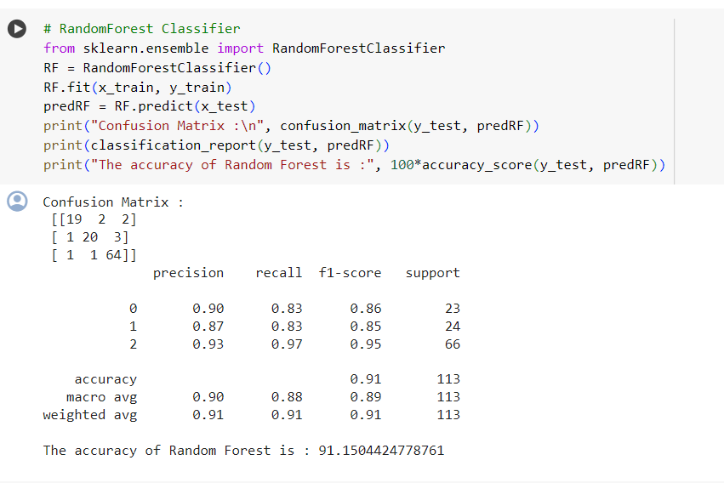

Slide 18
8. RESULTS
The results of all the models in one table. Here's a tabular representation of the accuracy, precision,
recall, and F1-score for each model:
Let's compare the accuracy of all models and determine the one with the highest accuracy:
Logistic Regression: 88.50%
Decision Tree: 86.73%
Random Forest: 91.15%
Gaussian Naive Bayes: 87.61%
Support Vector Machine: 65.49%
XG Boost:89.38%

Slide 19
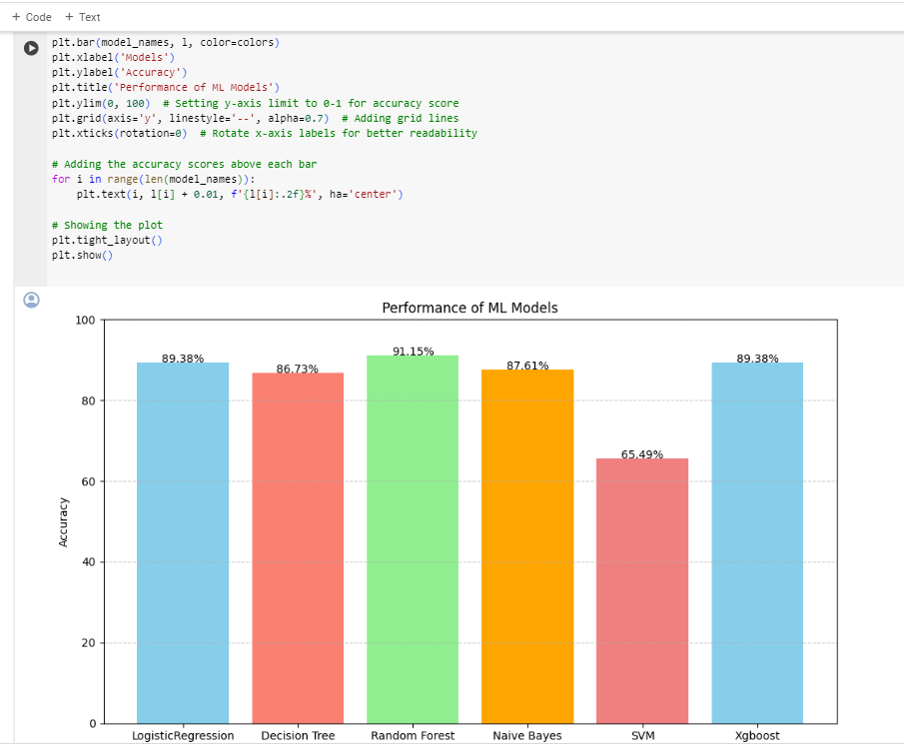

Slide 20
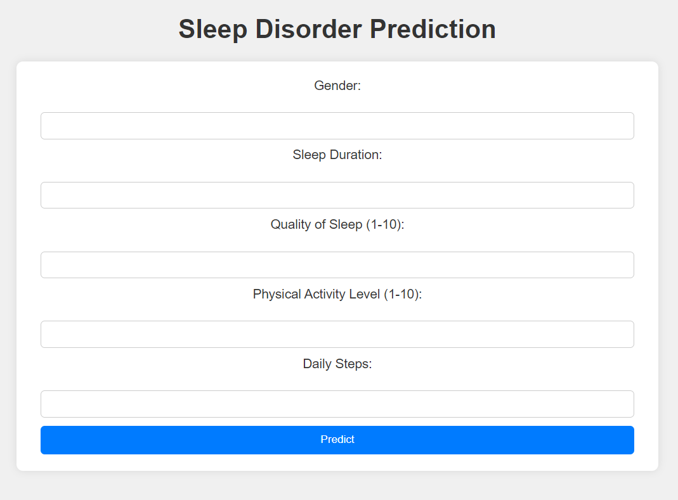
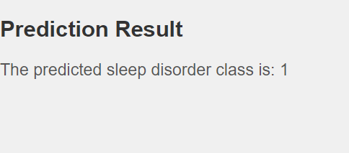

Slide 21
9. CONCLUSION AND FUTURE ENHANCEMENT
In this machine learning approach to predict insomnia, several key findings and conclusions have emerged:
The Random Forest model demonstrated the highest accuracy among the tested algorithms, achieving an accuracy of 91.5%. This high accuracy suggests that machine learning models can effectively predict the likelihood of insomnia based on the provided features.
Future research could focus on refining the model with additional data sources and advanced feature engineering techniques to enhance prediction accuracy.
Deployment of the model in healthcare settings and integration into digital health platforms can facilitate widespread access to insomnia risk assessment and management tools
The machine learning approach to predicting insomnia offers valuable insights into the complex interplay of demographic, health, and lifestyle factors contributing to sleep disturbances. By leveraging predictive models, healthcare providers can tailor interventions to individual needs, ultimately improving sleep quality.

Slide 22
While the initial focus of this project is on predicting insomnia using machine learning algorithms, there are several avenues for future enhancement and expansion:
Collaboration with Healthcare Providers: Collaborating with healthcare providers and integrating the predictive model into existing healthcare systems can enable early detection and intervention for individuals at risk of insomnia. This could involve deploying the model in clinical settings, telemedicine platforms, or wellness programs to support healthcare professionals in delivering personalized care for patients with sleep disorders.
User-Friendly Interfaces: Developing user-friendly interfaces and mobile applications can facilitate widespread adoption of the insomnia prediction model. Providing individuals with actionable insights into their sleep patterns, along with personalized recommendations for improving sleep quality, can empower them to take proactive steps towards better sleep health.

Slide 23
10. References
[1] A systematic way of collecting data of insomniac patients: an analytical survey- Md. Muhaiminul Islam, Abu Kaisar Mohammad Masum, Sheikh Abujar, Syed Akhter Hossain,2020
[2] "Insomnia and risk of cardiovascular disease: a meta analysis - Francesco Sofi, Francesca Cesari, Alessandro Casini, Claudio Macchi, Rosanna Abbate, Gian Franco Gensini, 2014", SAGE Journals, 2020.
[3] M. Bar, G. Schrieber, N. Gueron-Sela, G. Shahar and L. Tikotzky, "Role of Self-Criticism, Anxiety, and Depressive Symptoms in Young Adults’ Insomnia", International Journal of Cognitive Therapy, vol. 13, no. 1, pp. 15-29, 2020.
[4] Y. Zhang et al., "Worldwide and regional prevalence rates of co-occurrence of insomnia and insomnia symptoms with obstructive sleep apnea: A systematic review and meta analysis", Sleep Medicine Reviews, vol. 45, pp. 1-17,2019.
[5] “Sleep stress level classification through machine learning algorthims” - Vinak Singh,
Mahendra kumar Gourisaria,Himansu Das,2022.”
[6] Choi SJ, Kim D, Hwang Y, Jo H, Joo EY. Sex differences in etiologies of sleep disorders. Sleep Med 2020;17(2):138-147

Slide 24
Thank You

